Slide 1





Introduction to TRS Reporting

Slide 2
Disclosure
This presentation is intended as a high level overview of TRS reporting. This presentation should not be viewed as a comprehensive overview of the TRS reporting process.
The information in this presentation is based on the TRS Laws and Rules as of the current fiscal year
Please see the various RE Portal training and resources available on the TRS website for more complete information.

Slide 3


Welcome
Create a base knowledge of TRS reporting based on TRS Laws & Rules
Focus on what SHOULD be reported
Will be showing where to find information on the TRS Website
Send questions to: reporting@trs.texas.gov

Slide 4
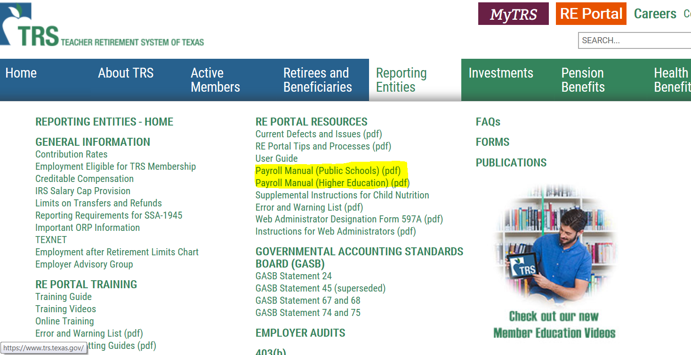
Online Resources – Payroll Manuals

Slide 5
Due Dates & Penalties
Regular Payroll & Corresponding TEXNET Deposits
  6th of month following report month *
Employment After Retirement & Corresponding TEXNET Deposits
  10th of month following report month *
  Exception: August ER Report
*Unless due date falls on weekend or federal holiday, then reports and deposits are due the previous business day.
Penalty Interest
Late TEXNET & Positive Report Corrections
VS.
Penalty Fee
Late/Incomplete Reports

Slide 6

What to Submit
Employee Demographic (ED)
No signature needed / Not a Required Report
Regular Payroll (RP)
Employment After Retirement (ER)
OR if no retirees employed
Report Detail
Report Detail
Signature
TEXNET
Report Detail
Signature
TEXNET
(If needed)
Zero Signature
TEXNET Deposit

Slide 7

Part 1 – Active Employees
Lesson 1
Employee Demographic Report
TRS Eligible Employment
View Employee Information
ED Records
Lesson 2
Regular Payroll Report
Creditable Compensation
Employer Contributions
RP Records

Slide 8
All Employees "Full Payroll”
regardless of eligibility or position
Required:
  TRS Eligible Employees
  Non-Eligible Employees
    Substitute
    Less than Half Time
    ORP Participants (Higher Ed. Only)
  Seasonal/Casual Employee
  All Non-TRS Retirees (ERS, Out of State, Private Sector)
Not Required:
  Student Employees
    *Entities of Higher Education Only*-condition of employment in the position requires employee to be enrolled as a student at your institution.

Slide 9
TRS Eligible Employment
Three Requirements
Must be established through a single employer
Working ½ time or more of the FTE for the position (not the person)
Definite period of time 4 ½ months (18 weeks) or longer
OR
Undefined amount of time
Comparable rate of pay

Slide 10

Considerations for Eligibility – Concurrent Employment
Combine multiple positions at ONE employer to meet eligibility
  Different FTEs for each position
If eligible at one employer, then all employment with TRS-covered employers is reported as eligible
  Exceptions:
    Substitute work is not considered employment for TRS purposes
    Student Employment is not considered employment for TRS purposes

Slide 11


Additional Considerations for Eligibility
Substitute Work
  A person who serves on a temporary basis in the place of a current employee and is paid at the daily rate of pay as set by the employer.
No Full-time Equivalent (FTE)
Earning a Year of Service Credit
Notes:
What is FTE? Define it for the entities.

Slide 12
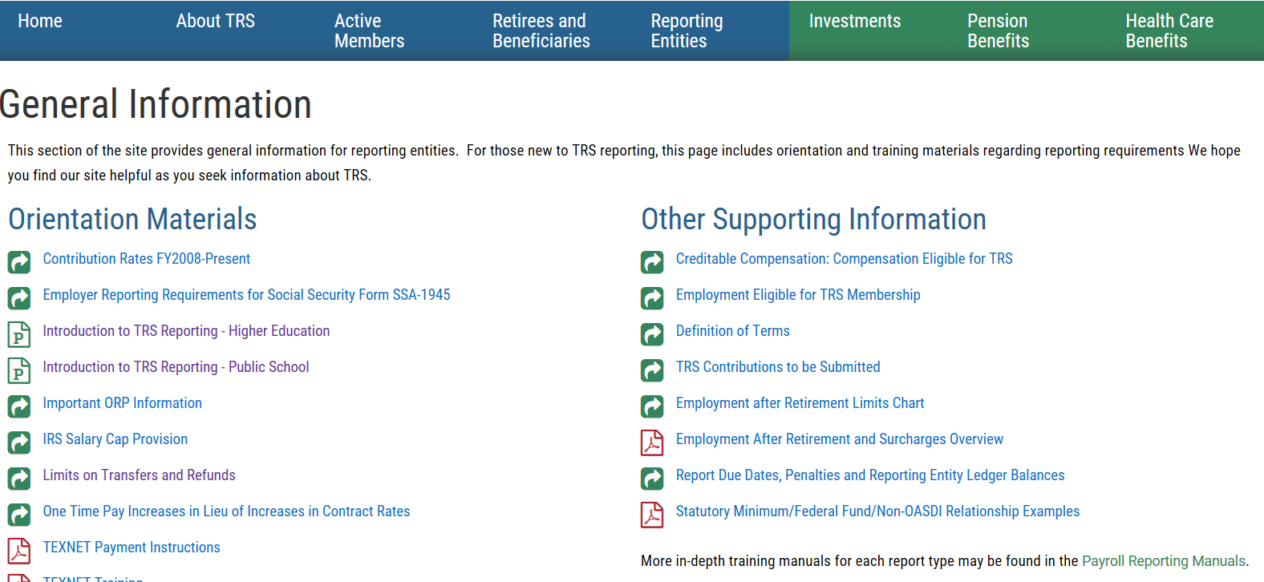
Online Resources for Eligibility

Slide 13

View Employee Information Screen
Look up all new hires
Enter SSN and either last name or DOB - Not all 3
Screen will let you know:
  If person is already a TRS member
  If New Member Contributions due
  If person is a TRS retiree
    Person’s retirement date
    If retiree is subject to surcharges
  If person has elected ORP

Slide 14
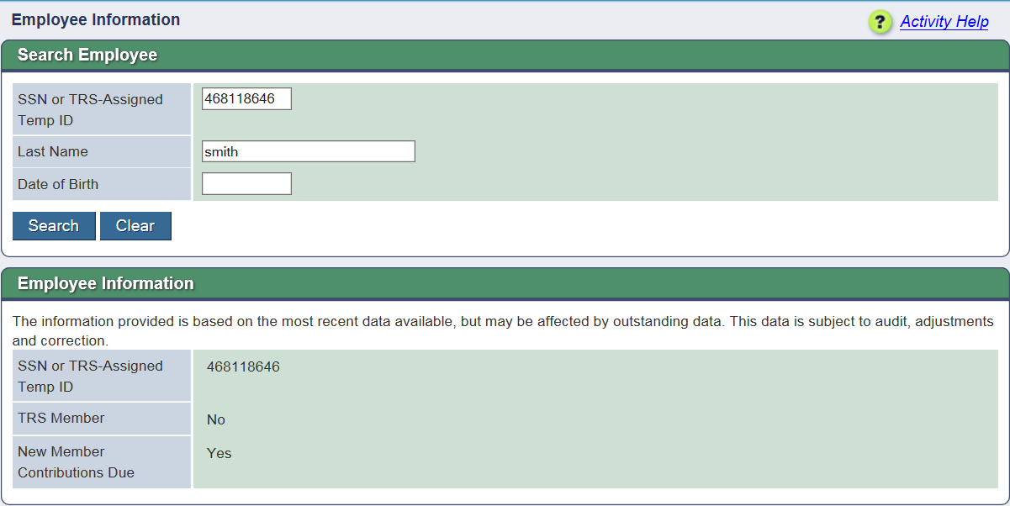
View Employee Information – No TRS Account
Notes:
If TRS has a different Last Name or DOB than what is used in search, may result in No TRS Account. If all three search fields are entered, will result in no findings.

Slide 15
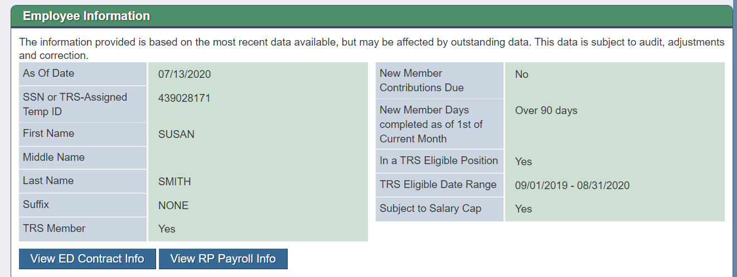
View Employee Information---Current TRS Member

Slide 16
Employee Demographic (ED) Report
The purpose of the Employee Demographic Report is to create and maintain information for TRS participants
ED20, ED25, ED40, ED45 & ED90
Can submit and complete as many ED reports as needed each month
Examples of when to send ED records
New Employee
ED20 or ED25
ED40
Change Positions
ED45 to End/Add*
Terminate ALL Employment
ED90
Notes:
ED 25- do not submit address changes. Form 358. Only fields that can be deleted: First Name, Middle Name & Generation. Sending documentation is not allowed unless error received “cannot change, contact TRS”.

Slide 17
Important Fields on ED 40
Position code
Employment type
Membership eligibility flag
Non Standard Work Week
ORP eligible position flag
Entitled to group benefits under UT/A&M/ERS

Slide 18
ED 45 Record
The purpose of the ED 45 record is to edit, end, end/add or delete position information for TRS participants
Examples of when to send ED 45 records
Edit
Incorrect original information
End
Position ends prior to expected, not termed
End/Add
Original position ends, new position
begins immediately
Delete
Position record submitted in error

Slide 19


Employment and Positions
An ED20 record sent for a new employee creates a new employment
An ED40 record then adds positions (contracts) under that employment
  Each employment can hold multiple positions
Each RP20 must have a matching position to post to
Employment
Part-time Position
Full-time Position
RP record

Slide 20
Sending the ED45 in the SAME month as the change
Employment
Sep. 2018
18 d / 65 h
$0
Oct. 2018
19 d / 70 h
$1,300
Nov. 2018
13 d / 45 h
$1,400
Dec. 2018
12 d / 40 h
$900
62
days
Part-time Position
Send ED45
to
End PT &
Add FT
Position
Jan. 2019
18 d / 144 h
$800
Feb. 2019
19 d / 152 h
$2,400
March 2019
15 d / 120 h
$2,400
96
days
Full-time Position
April 2019
22 d / 176 h
$2,400
May 2019
22 d / 176 h
$2,400
20
Notes:
In the following example an employee started employment with their entity in a Part-time (non-eligible) position and was expected to work from 09/01/18 – 05/31/19
This employee then accepted a Full-time (TRS eligible) position as of 01/01/2019
Let’s look at the RP postings and the importance of sending the ED45 at the correct time

Slide 21
Sending the ED45 AFTER the position change
Employment
Sep. 2018
18 d / 65 h
$0
Oct. 2018
19 d / 70 h
$1,300
Nov. 2018
13 d / 45 h
$1,400
Dec. 2018
12 d / 40 h
$900
80
days
Part-time Position
Send ED45
to
End PT &
Add FT
Position
Jan. 2019
18 d / 144 h
$800
Feb. 2019
19 d / 152 h
$2,400
March 2019
15 d / 120 h
$2,400
78
days
Full-time Position
April 2019
22 d / 176 h
$2,400
May 2019
22 d / 176 h
$2,400
Notes:
If the correct steps are not taken, RP records will have to be reversed and then added back to the account correctly.

Slide 22

ED 90 – Final Report Month
The Final Report Month (FRM) must be the final month TRS contributions will be reported to TRS.
Employment
Employment
Employment
Part-time Position
Full-time Position
Full-time Position
Part-time Position
Full-time Position
Part-time Position
Substitute
Full-time Position
Part-time Position
Notes:
Current:
Open Employment – Contains only Ineligible Positions
RE should not report a Final Report Month on the ED 90.
If the RE inputs a Final Report Month on the ED 90- the expected result is a Warning message
If the RE does not input a Final Report Month on the ED 90- no message
Open Employment – Contains only Eligible Positions
RE must report a Final Report Month on the ED 90.
If the RE inputs a Final Report Month that is more than 2 months after the termination date- Error Message
If the RE does not input a Final Report Month on the ED 90- Error Message
Open Employment – Contains Eligible and Ineligible Positions
RE must report a Final Report Month on the ED 90
The FRM must be the last report period of the TRS Eligible Position
If the RE does not input a Final Report Month on the ED 90- Error Message
If the RE inputs a FRM that is more than two months after the end date of the Eligible position- Error Message
There is no time limit on the Final Report Month if the open employment contains a TRS eligible position.

Slide 23

ED to RP Report
Lesson 2
Complete ED Report Prior to Submitting RP Report

Slide 24

RP Report
The purpose of the Regular Payroll Report is to report employee payroll data
Creditable Compensation
Member Contributions
Employer Contributions

Slide 25

TRS Creditable Compensation
Payment for services rendered
Earned or accrue proportionally as the work is performed
Paid at fixed intervals
Not specifically excluded under applicable laws and rules
Creditable Compensation

Slide 26
TRS Creditable Compensation Examples
Creditable:
  Stipends for sponsorship of classes or clubs
  Pay for additional duties
  Overtime when paid as earned
  Paid time off in lieu of working
  Performance Pay (see next slide)
Not Creditable:
  Bonuses
  Incentives
  Reimbursements
  Overtime when paid at a later date
  Pay for unused leave

Slide 27
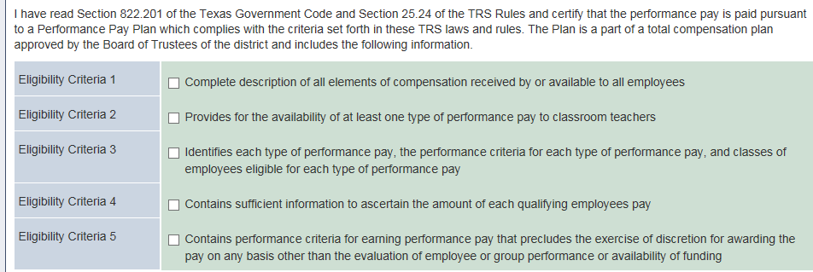
Performance Pay
Only applies to ISDs and Charter Schools
Must certify through My Worklist before reporting
Payment must meet all five criteria above to be certified as Performance Pay

Slide 28
Online Resources for Creditable Compensation

Slide 29

TRS Member Contributions
Member Retirement Contribution
  7.7% of TRS Creditable Compensation
Member TRS-Care Contribution
  0.65% of TRS Creditable Compensation
Special Service Credit Purchase
  Member must have active installment agreement with TRS for payroll deduction
Notes:
Entitled to Group Health Benefits through ERS/UT/A&M flag- how it affects member & RE TRS-Care. Must be retired from one of these systems for flag to be Yes.

Slide 30
Employer Contribution on the Regular Payroll Report
ISD
Reporting Entity TRS-Care
Federal Fund/Private Grant
Federal Grant TRS-Care
Statutory Minimum Contribution (certain public schools)
Reporting Entity Payment for New Members
Public Education Employer Contribution (formerly RE Payment for Non-OASDI Members)
Charter Schools
Reporting Entity TRS-Care
Federal Fund/Private Grant
Federal Grant TRS-Care
Statutory Minimum Contribution
Reporting Entity Payment for New Members
Public Education Employer Contribution (formerly RE Payment for Non-OASDI Members)
Region Service Center
Reporting Entity TRS-Care
Federal Fund/Private Grant
Federal Grant TRS-Care
Reporting Entity Payment for New Members
Public Education Employer Contribution (formerly RE Payment for Non-OASDI Members)

Slide 31
RP Report – New Member
New Member Contributions are due on pay received during an employee’s first 90 days of TRS membership, not when the employee is paid for work performed during the first 90 days
Do not report the new member with Federal Fund/Private Grant, Statutory Minimum, Educational/General-Local, Non-Educational/General or Community/Junior College Contributions until AFTER the first 90 days of employment (if applicable)
BUT Do report the new member on the Federal Grant TRS-Care contribution DURING the first 90 days
If employee termed in prior report period, current report period is only final compensation. New Member is not due for final month.

Slide 32
New Member Contribution Example
September
Started 9/1/19
20 days
$0 pay
October
Terminated 10/31
23 days
$5,000 pay
November
0 days
$5,000 pay
No New Member due
New Member contributions due
No other state contributions
No New Member due
Would pay any other state contributions

Slide 33
RP Report – Federal Fund/Private Grant
Purpose - to report on a monthly basis the amount of salary paid from federal funds and private grants to a TRS-eligible employee and to reimburse the State for the State contribution due on the salary
The Child Nutrition is reported under Federal Fund/Private Grant
Child Nutrition Supplemental Instructions

Slide 34
RP Report – Federal TRS Care
Purpose - to report on a monthly basis the amount of salary paid from federal funds and private grants to a TRS-eligible employee and to reimburse the State for the State’s contribution to the Texas Public School Retired Employees Group Insurance Program (TRS-Care).

Slide 35
RP Report – Statutory Minimum
The purpose of the Statutory Minimum Contribution is to report on a monthly basis the state contribution on the salary paid above the state minimum salary.
Members employed as teachers, full-time librarians, full-time counselors or full-time nurses.
Members who would have been entitled to the state minimum salary under former Section 16.056 of the Texas Education Code, as that section existed on January 1, 1995. Entity’s responsibility to classify and apply consistently based on the position, not person.
Statutory Minimum Examples

Slide 36
RP Report - Statutory Minimum
Statutory Minimum previously applied only to Independent School Districts (ISDs).
As of September 1, 2019, HB3 requires Open Enrollment Charters to pay the state’s contribution on salary amounts in excess of the state minimum salary schedule published by TEA.
This applies to charter school employees who would be entitled to the state minimum salary if employed by a school district
Notes:
House bill 3 requires Charter schools to pay the state contribution on salary amounts paid above the state minimum salary schedule published by TEA.
This applies to charter school employees who would be entitled to the state minimum salary if employed by a school district as a teacher, full time counselor, full time librarian, or full time nurse. Additionally, those positions which were entitled to a minimum salary under former section 16.056 of the Texas Education Code are also subject to this contribution.
Let’s take a closer look:

Slide 37
Compensation Subject to Statutory Minimum
Compensation paid for services performed:
  As a teacher, full-time librarian, counselor, or nurse;
  OR
  In a position covered under former Section 16.056* of the Texas Education Code (i.e., superintendent, principal, administrative officer, instructional officer, diagnostician, etc.);
  PLUS
  Any supplemental pay for duties that are part of a particular position that is subject to the state minimum salary. Examples include, but are not limited to: stipends for sponsorship, UIL activities, coaching duties, tutorial assignments.

Slide 38


Wholly Separate – Not Subject to Statutory Minimum
Payment for duties that constitute a “wholly separate” job are excluded from the adjusted TRS salary for the purpose of this report. Examples include, but are not limited to: driving a school bus, maintenance work, custodial work, teaching summer school.
Notes:
Examples to discuss: Coach driving a bus (job requirement vs wholly separate), Tutoring
Refer to 6 questions in payroll manual to help them determine Wholly Separate
Summer School Position Code planned for future to assist with reporting.

Slide 39

RP Report – Public Education Employer Contribution
Applies to ISDs, Charter Schools, and Education Service Centers.
Purpose - to remit on a monthly basis a percentage of the total amount of eligible salary paid to a member. (1.5% in FY20, 1.6% in FY21)
For ISDs only: If the position is subject to the state minimum salary schedule, the Public Education Employer contribution is due only on the salary amount up to the adjusted state minimum.

Slide 40
RP Report
Report Types
Regular Payroll
(Current Month)
RP – Adjustment
(Ad-hoc adjustments)
Record Types
RP20 – Current Month Record
RP25 – Adjustment Record (add, edit or delete)

Slide 41

Report Requirements
Report salary when it is paid to the employee
  Regardless of when it was earned
Report time (days and hours) when worked
  Time reporting is not based on pay period

Slide 42

Hours Worked vs. Hours Scheduled
For Active employees
  If an employee tracks their time (keeps timesheet or clocks in and out), you MUST report the actual hours worked in the calendar month
  If an employee does not track their time in any way, you will report the number of hours they are scheduled to work each week.

Slide 43

Part 2 – TRS Retired Employees
Lesson 1
Retiree Rules & Laws
View Employee Information
Half-time Exception
Independent Contractor
Lesson 2
ER Report
Surcharges
Common Errors
Send questions to: reporting@trs.texas.gov

Slide 44
Who to Submit
Employment After Retirement
All
TRS
Retirees
Regardless of Retirement Date or Position

Slide 45
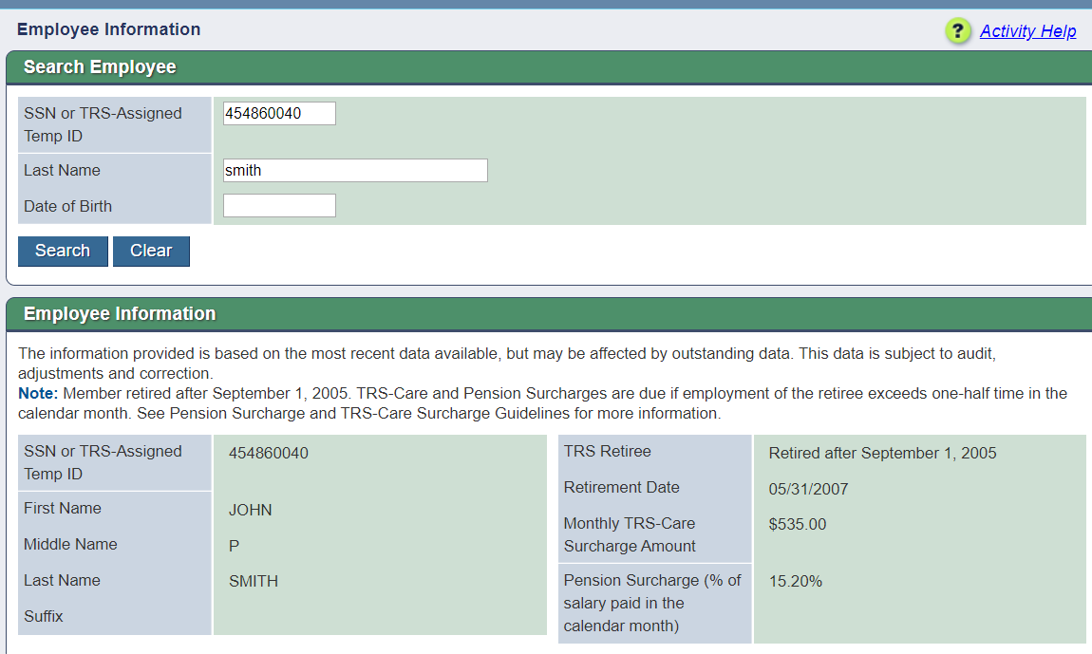
View Employee Information – TRS Retiree

Slide 46
Three Categories of Retirees
Retired BEFORE September 1, 2005 | Retired between September 1, 2005- January 1, 2011 | Retired AFTER January 1, 2011
Retiree may work without limit and receive annuity | Retiree may work without limit and receive annuity | Retiree limited to working one-half time or less or substitute UNLESS there has been a 12-consecutive month break in service
No surcharges due | Surcharges due if retiree works more than amount allowed | Surcharges due if retiree works more than amount allowed
Three Categories

Slide 47
One-Half Time for Retirees
One-half time for Employment After Retirement AND Surcharges is defined as:
  Working the equivalent of 4 clock hours for each workday in the calendar month under the one-half time exception.
  The total number of hours allowed for that month may be worked in any arrangement or schedule.
  Workday is defined as Monday -Friday, regardless of whether reporting entity is open or closed**
  When a retiree combines substitute and one half time employment in the same calendar month, the retiree may work only one-half the number of workdays in that calendar month.
**This is for Employment After Retirement and Surcharge purposes ONLY, not Active members**

Slide 48
Employment After Retirement Limits Chart
Month | Total Number of Workdays in Calendar Month | Number of Hours a Retiree Working One-Half Time or Less May Work Without Triggering Surcharges | Number of Workdays Retiree Combining Substitute and Other TRS-Covered Employment May Work Without Triggering Surcharges
September 2019 | 21 days | 84 hours | 10 days
October 2019 | 23 days | 92 hours | 11 days
November 2019 | 21 days | 84 hours | 10 days
December 2019 | 22 days | 88 hours | 11 days
January 2020 | 23 days | 92 hours | 11 days
February 2020 | 20 days | 80 hours | 10 days
March 2020 | 22 days | 88 hours | 11 days
April 2020 | 22 days | 88 hours | 11 days
May 2020 | 21 days | 84 hours | 10 days
June 2020 | 22 days | 88 hours | 11 days
July 2020 | 23 days | 92 hours | 11 days
August 2020 | 21 days | 84 hours | 10 days
Example

Slide 49
ER Report – Other Considerations
Retirees are considered employees during the first 12 consecutive-calendar-months following retirement if they are performing duties or providing services for an educational institution that an employee of the institution would otherwise perform and working as an independent contractor, volunteer or waiving compensation.
RULE §31.11
Sec. 824.601

Slide 50

ER Report – Other Considerations
Retirees substituting in a vacancy
  20 days per vacancy
  Cannot be vacancy created by retiree’s retirement
  Cannot be hired to fill position as the employee

Slide 51

Reporting Time Worked by Retirees
For TRS retirees
  You MUST report the actual days and hours worked in the calendar month.
  Reporting scheduled days and hours is not permitted

Slide 52
ER Report - Surcharges
Pension Surcharge based on the pay received in the month the retiree exceeded the half-time exception, regardless of when the money was earned.
TRS-Care Surcharge due in the month the retiree exceeded the half-time exception, regardless if the retiree receives pay that month.
September
Substitute
October
Full-time
November
Substitute

Slide 53
ER Report
Report Types
Employment After Retirement
(Current Month)
ER – Adjustment
(Ad-hoc adjustments)
Record Types
ER20 – Current Month Record
ER25 – Adjustment Record-Add
ER27-Adjustment Record-Edit or Delete

Slide 54
ER Report
The purpose of the Employment after Retirement Report (ER Report) is to report, on a monthly basis, the TRS retirees returning to work.
Retiree hours, days and salary must be reported on all retirees regardless of retirement date.
Surcharges are strictly based on the actual number of hours or days the retiree has worked or was on paid leave during the calendar month.

Slide 55


ER Zero Signature
Submitting and confirming a zero signature will complete the ER report for that month.
If done in error, that month’s ER records mist be submitted on an ER Adjustment report as ER25s.

Slide 56


ER Report – Overlapping Dates
Retiree began employment as a substitute employee. In February, employee became a full-time employee.
September
August
Sep. 1st – June 1st , Position Code 02 , Substitute
Sep. 1st – June 1st , Position Code 02 , Full-time
September
August
Sep. 1st – June 1st , Position Code 02 , Substitute
Feb. 1st – June 1st Position Code 02 Full-time
September
August
Send ER27 on ER – Adjustment Report to END first position
Sep. 1st – Jan. 31st Position Code 02 Substitute
Feb. 1st – June 1st Position Code 02 Full-time

Slide 57

Resolving Errors
Error messages do not always tell the user exactly how to correct the error, but often, the error message can guide the user to the solution.
The following slides contain examples of common errors and the guidance contained in the error message:
Notes:
Error messages cannot always tell a user exactly how to correct the issue because the system does not know what is correct and what is not.
For example, if the error says an eD40 for Position Code 01 does not exist, but an ED40 for Position Code 02 is on file, which position code is correct?
The goal is to problem solve based on the error message shown by analyzing what the error means.

Slide 58
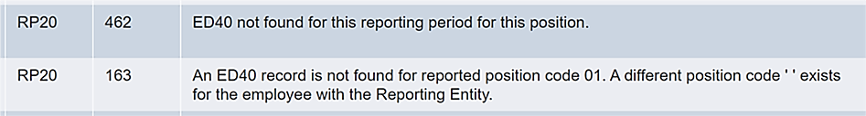
Error: ED40 not found
Consider:
  Has an ED40 been submitted for this position for this fiscal year?
    If yes, has the record posted/completed?
      If so, what were the employment dates on that ED40?
  Did the contract end prior to this report month?
    If yes, are you reporting time worked on this month’s record?
  Have you resubmitted the RP file after the ED records processed and posted?

Slide 59
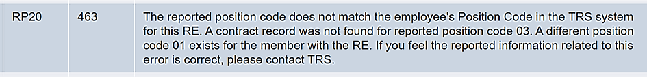
Error: Reported Position Code Does Not Match
Consider:
  Did the person change positions?
  Did they take on an additional job?
  Are you reporting the correct position code?
  Have you resubmitted the RP file after the ED records processed and posted?
Notes:
If there is not an additional job, but this is a TRS eligible stipend paid to an employee as part of their usual job it should be included with the employee’s regular position code. Check with your software provider to ensure that the stipend is coded correctly.

Slide 60
Reported information does not match TRS information
Consider:
  Verify that what you are reporting is correct.
  What was reported previously?
ED25
Update Name, Date of Birth, Gender, ID/SSN
  Reported Name must match Social Security card
  Date of Birth and Gender must match government issued ID
ED45
Update any information previously reported on an ED40.

Slide 61
Contribution of xx is not correct amount. Contribution is xx%
Consider:
  Is this an adjustment for a previous month or year?
    If so, was any contribution reported on the original record and are you considering that in these calculations?
  Is this a current month record?
    If so, verify that all the compensation amounts from various funding sources is accurate.
Notes:
If adjusting a previous year, were the contribution rates different at that time?
Review the interaction between Federal Funds, Statutory Minimum, and Public Education Employer Contribution :
https://www.trs.texas.gov/Pages/re_statutory_minimum_examples.aspx

Slide 62
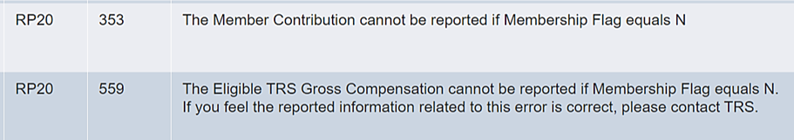
Cannot report XX contributions when membership flag is N
Consider:
  Has the person changed eligibility status?
    If so, has an ED45 been submitted to update the eligibility flag?
  Is this final pay from a previous position that was eligible?
Notes:
If the person is/was not eligible and contributions were withheld in error, refund them back to the member.

Slide 63
Member contributions must be reported when membership flag is Y
Consider:
  Is the person TRS eligible?
  What was the eligibility flag on the ED40?
  If it was Yes, why aren’t eligible compensation and contributions reported?
  Has the person changed eligibility status?

Slide 64
Cannot change membership flag due to posted transactions
Consider:
  Was eligibility reported incorrectly back to beginning of contract?
  If changing to No-
    Were any TRS contributions reported?
  If changing to Yes-
    Will you be going back to beginning of current eligible contract and collecting contributions?
  Has the person changed eligibility?
Notes:
ED45 functionality-
Edit vs. End/Add
ED45 - Contract & Position Adjustment Record - Examples
Edit a previously submitted and TRS-accepted ED40 record. If the position code, dates, or any other information were wrong on the original ED40, submit an ED45 with an Adjustment Reason Code of “E” (Edit) and put the corrected information in the applicable “New” fields. The ED45 must have the exact same Beginning Date of Contract/Work Agreement for the same FY as the originally accepted contract. The original contract is voided and is replaced by the information on the new ED45.
End/Add a previously submitted and TRS-accepted ED40 record. This allows the ED45 to both end an existing contract/position record and start a new contract/position going forward. Unlike an Edit, the End/Add functionality does not replace the original contract/work agreement as it remains on the system. The original contract/work agreement is given a new ending date of the day prior to the beginning date of the new contract/work agreement and another contract/work agreement is added to the system using the new information on the ED45. Instead of submitting an ED45 to end the old position and then submitting an ED40 to start the new position, an ED45 with an Adjustment Reason Code of “A” (End/Date) can be reported to reflect a change in position. All “New” fields need be to be reported if the Adjustment Reason Code is “A” even if the previously reported data will be the same for the new position.

Slide 65


Verify Membership Eligibility
Consider:
  Are reported hours correct?
  Did person change positions/eligibility?
Notes:
If eligibility has not changed, provide answers to the following questions to your coach for an override:
How many hours per week employee hired to work?
The position’s FTE (must be either 00 or between 30-40)
Explanation why hours are more or less than expected for this report month
Statement of when employee is returning to agreed upon hours

Slide 66
ER-Reporting information does not match reported data from prior report period
Consider:
  Has retiree’s position code, employment type, or employment dates changed?
  What was reported on the previous month’s report for these fields?
Notes:
Retiree Employment type is based on what retiree actually did that month, not what they were hired to do.
If there have been no changes, edit the current record to match what was previously reported.
If any changes have occurred, an ER27 to adjust the previous month and end that position must be sent.

Slide 67
Software Provider or TRS?
Who to contact for help
Software Provider support:
  Lead Record error---totals in report do not match lead record
  Errors in your software
  Reports not generating from your system correctly---pulling additional records, putting people on wrong report
TRS Coach:
  Report has been uploaded and processed and assistance is needed with error
  Clarification on TRS Laws and Rules
  Employment after Retirement rules regarding surcharges
Notes:
Contact a TRS Benefit Counselor for:
Any member questions regarding general account information, and:
Refunds
Retirement Benefits
Death Benefits
Employment after Retirement rules regarding retiree limits
In most cases, the member must contact TRS themselves---TRS is not able to provide member account information to the employer without authorization from the member.

Slide 68
Communicating with your coach effectively
Compile all questions into one email whenever possible
Be as clear and complete in your question as possible---give details
Send full screenshots—not just the error message itself
If coach gives instructions to make corrections, follow them in order
Notes:
Please ensure you are sending any emails that contain personally identifying information in a secure or encrypted manner.
Information to include in your email:
What report is this on?
What employee is the error on?
What have you tried to resolved the error on your own?
If so, what have you tried?
What errors are you getting?
If position changes occurred, include dates.

Slide 69
Overrides
Amount of time to prepare an override
  approx. 1-5 minutes for each record being overridden
Documentation Required
  screenshot of the record
  communication from RE explaining why override is needed
  screenshot of contracts on file
  screenshot of TRS28
  screenshot of transactions screen
Notes:
Some overrides are due to defects. Many are due to validations working exactly as designed, but reported information is correct. Overrides are a way for TRS to verify that reported information fits within TRS Laws and Rules.
SAO requires full documentation of explanation and support for all overrides.

Slide 70
Coach Statistics
1330+ active Reporting Employers
17 coaches (including 4 in training)
Coaches work with between 85-130 Reporting Employers
Notes:
Training time for new coaches is 6-8 months
Currently 2 vacancies for coaches remain
Average number of phone calls per month:
Incoming: 307
Outgoing: 707
Voicemails received: 355
Average time for incoming calls: 26 minutes
Average time for outgoing calls: 10 minutes
Average number of emails per week:
Incoming: 3808
Outgoing: 2701
Average number of overrides processed per month:
449

Slide 71
Available Resources
  Custom Web Messages
  Error messages
    Think about ‘Considerations’ on previous slides
  Errors and Warnings list
  Report Format Guide
  Payroll Manuals
  Current Defects and Issues Document
  Update Newsletters
  Employer Advisory Group members
Notes:
TRS launched the Employer Advisory Group (EAG) in 2017 to facilitate communication between TRS and Employers.
The EAG’s purpose and goal are for TRS and Employers to have a common understanding of any issues related to reporting requirements and work together jointly to identify practical ways to comply with new laws, rules, and accounting requirements.
The group includes TRS Benefit Services Staff and representatives from all reporting employer types, sizes and locations. Their participation is voluntary and does not imply that the members are in agreement with all decisions ultimately made by TRS.
If there are issues or questions you would like to be brought up in an EAG meeting, please visit the TRS Website for a list of EAG members and contact the representative for your region.

Slide 72
Empowerment
Try it! Everything can be fixed
Believe in your knowledge-you know more than you think
Trust your abilities
Use your resources
We believe in your knowledge and abilities!

Slide 73

Reporting Employer Contacts
Required Contact Types:
  Web Administrator
  Head of Institution
  Reporting Official
  Payroll Contact
Web Administrator
  Update Reporting Entity’s contacts
  Updated by TRS with TRS 597a form
  Role assigned by Head of Institution
  Reset passwords for internal users
Contacts on file for the Reporting Entity will receive valuable information from TRS

Slide 74

Please reach out to your coach or reporting@trs.texas.gov if you have any questions or need assistance.

