Slide 1





Summer 2020
Higher Education
Reporting Employer Training

Slide 2
Disclosure
This presentation is intended as a high level overview of TRS reporting. This presentation should not be viewed as a comprehensive overview of the TRS reporting process.
The information in this presentation is based on the current TRS Laws and Rules at the time of this presentation.
Please see the various RE Portal training and resources available on the TRS website for more complete information.

Slide 3


Welcome
Create a base knowledge of TRS reporting based on TRS Laws & Rules
Focus on what SHOULD be reported
Will be showing where to find information on the TRS Website
Email Questions to: REOutreach@trs.texas.gov

Slide 4
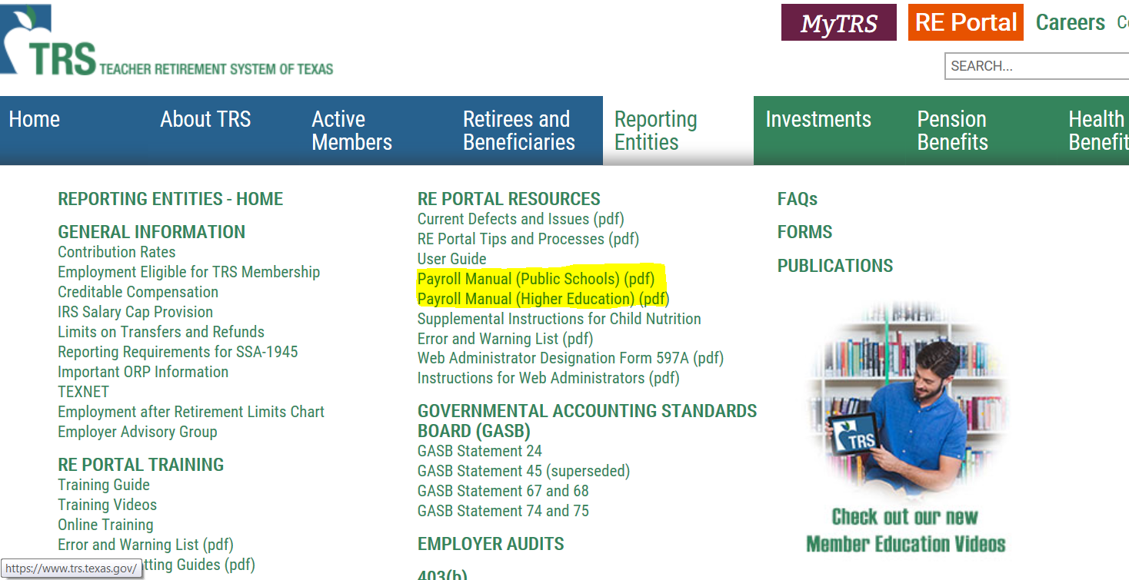
Online Resources – Payroll Manuals

Slide 5

Due Dates & Penalties
Regular Payroll & Corresponding TEXNET Deposits
  6th of month following report month *
Employment After Retirement & Corresponding TEXNET Deposits
  10th of month following report month *
  Exception: August ER Report
  * Unless due date falls on weekend or federal holiday, then reports and deposits are due the previous business day.
Penalty Interest
Late TEXNET & Positive Report Corrections
VS
Penalty Fee
Late/Incomplete Reports
TRS Update Newsletter

Slide 6
What to Submit
Employee Demographic (ED)
No signature needed / Not a Required Report
Regular Payroll (RP)
Employment After Retirement (ER)
OR if no retirees employed
Report Detail
Report Detail
Signature
TEXNET
Report Detail
Signature
TEXNET
(If needed)
Zero Signature
TEXNET Deposit

Slide 7
Who to Submit
Include:
TRS Eligible Employees
Non-Eligible Employees
  Substitute
  Less than Half Time
  ORP Participants (Higher Ed. Only)
Seasonal/Casual Employee
All Non-TRS Retirees (ERS, Out of State, Private Sector)
Not Required:
Student Employees- condition of employment in the position requires employee to be enrolled as a student at your institution.
All Employees "Full Payroll”
regardless of eligibility or position

Slide 8

Part 1 - Active Employees
Lesson 1
Employee Demographic Report
TRS Eligible Employment
View Employee Information
ED Records
Lesson 2
Regular Payroll Report
Creditable Compensation
Employer Contributions
RP Records

Slide 9
TRS Eligible Employment
Three Requirements
Must be established through a single employer
Working half-time or more of the FTE for the position (not the person)
Defined period of
4 ½ months (18 weeks) or longer
OR
Undefined amount of time
Comparable rate of pay
Employment Eligibility

Slide 10
Higher Education – Hour Conversion
Online Classes | Continuing Education Classes | All Other Instructors
Different standard used Must be offered for college credit Minimum of 2 clock hours for each semester/ credit/course hour | Includes adult education and employee training Not offered for college credit Count actual number of hours worked | Minimum of 2 clock hours for every hour spent in the classroom or lab If employer has established a higher ratio (ie. 2.25 clock hours for every hour in the classroom or lab) OK to use Use hours of instruction in the classroom or lab, not semester/ credit/course hour

Slide 11

TRS Definition of Adjunct
An instructor position with an institution of higher education filled on a semester-by-semester basis, compensated on a per class basis, and the duties include only those directly related to instruction of students in a class taken by students for college credit.
Employees who are hired to work independent studies should be considered as adjunct instructors and the hours conversion needs to be applied.
This Photo by Unknown Author is licensed under CC BY-SA
Notes:
New image – was word cloud

Slide 12

Adjunct Membership Eligibility
Must be hired to work at least 20 hours per week to be TRS eligible based on the following calculation:
Convert instructional time based on a minimum of two clock hours for each clock hour of instructional time in the classroom or lab unless the employer has established a greater amount of preparation time for each hour in the classroom or lab.

Slide 13


Adjunct Hour Conversion Examples
Adjunct Faculty Online:
3 credit hours x 2 = 6 clock hours x 3 courses = 18 clock hours per week. Not eligible for TRS.
3 credit hours x 2 = 6 clock hours x 4 courses = 24 clock hours per week. Eligible for TRS
Adjunct Faculty in Classroom:
Teaching 3 courses. Each course meets 1 hour per day, 3 times a week. 3 x 2 = 6 clock hours x 3 courses = 18 clock hours per week. Not eligible for TRS.
Teaching 4 courses. Each course meets 1 hour per day, 3 times a week. 3 x 2 = 6 clock hours x 4 courses = 24 clock hours per week. Eligible for TRS.

Slide 14

Adjunct Eligibility Examples
Less than half-time in fall; half-time or more in spring
  Becomes TRS eligible in the spring semester since total employment is more than 4 ½ months (Rule 25.1 (g))
Hired to work 20 hours or more only in the Fall semester
  Not TRS eligible and considered Temporary Employment
Hired to work 20 hours or more in the Fall semester with the understanding they may work in the Spring semester
  TRS eligible beginning in the Fall semester since total employment is expected to be more than 4 ½ months (Rule 25.1 (g))

Slide 15
Adjunct Eligibility Examples
Examples continued:
Hired to work 20 hours or more in any semester, but low enrollment and classes don’t make
  If classes dropped changes TRS eligibility, then the change is retroactive
Hired to work 20 hours or more in the Fall semester. Continues working in the Spring semester but less than 20 hours. Returns to working 20 hours or more in the Summer semester
  TRS eligible in the Fall semester, NOT TRS eligible in the Spring semester and back to TRS eligible in the Summer semester

Slide 16

Additional Consideration for Eligibility-Concurrent Employment
Combine multiple positions at ONE employer to meet eligibility
  Different FTEs for each position
If eligible at one employer, then all employment with TRS-covered employers is reported as eligible
  Exceptions:
  Substitute work is not considered employment for TRS purposes
  Student Employment is not considered employment for TRS purposes

Slide 17


Additional Considerations for Eligibility
Substitute
  A person who serves on a temporary basis in the place of a current employee and is paid at the daily rate of pay as set by the employer.
No Full-time Equivalent (FTE)
Earning a Year of Service Credit

Slide 18

View Employee Information Screen
Look up ALL new hires
Enter SSN and either last name or DOB - Not all 3 fields
Search results show you:
  If person is already a TRS member
  If New Member Contributions due
  If person is a TRS retiree
    Person’s retirement date
    If retiree is subject to surcharges
  If person has elected ORP

Slide 19
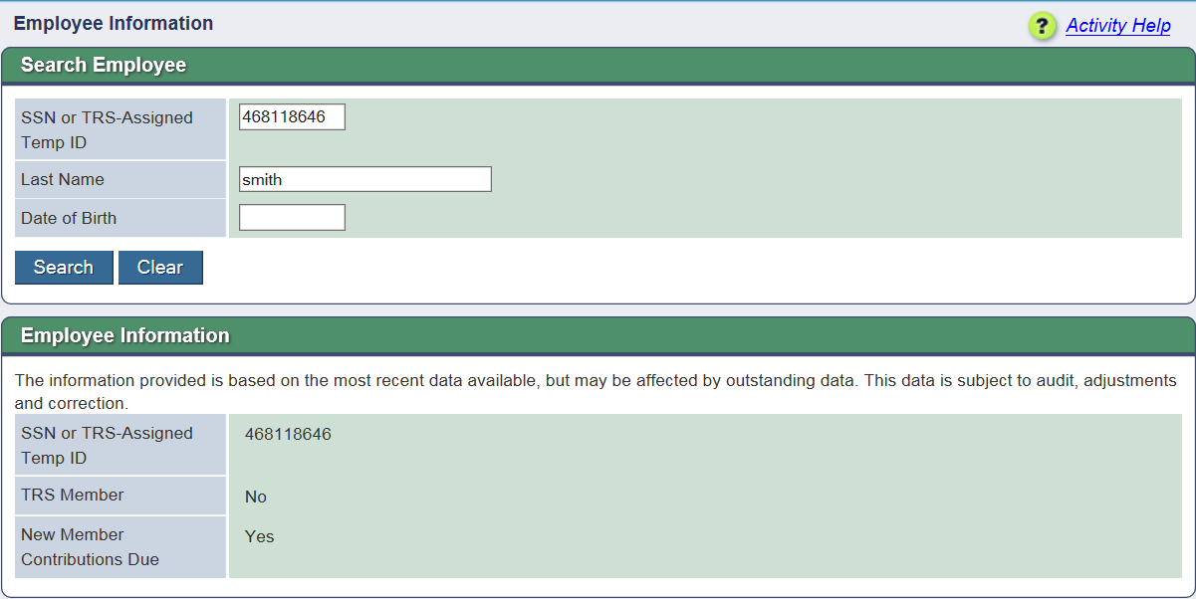
View Employee Information - No TRS account
Notes:
If TRS has a different Last Name or DOB than what is used in search, may result in No TRS Account. If all three search fields are entered, will result in no findings.

Slide 20
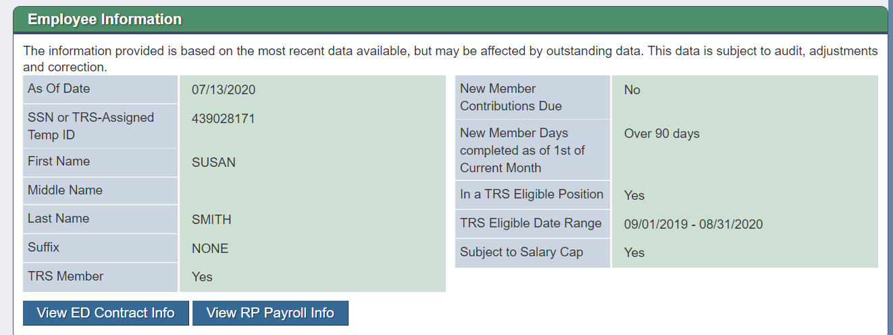
View Employee Information---Current TRS Member

Slide 21
Employee Demographic Report
The purpose of the Employee Demographic Report is to create and maintain information for ALL employees of TRS Reporting Employers.
ED20, ED25, ED40, ED45 & ED90
Examples of when to send ED records
New Employee | Change Position | Terminate Employment
ED20 or ED25 – Employee ED40 – Position | ED45 – Position End/Add | ED90 – Terminate with RE
* Only use End/Add only if changing directly from one position to another. If any days or gaps between positions, you must use an ED45 to first end and then an ED40 to report the new position.
Notes:
First bullet was corrected from:
The purpose of the Employee Demographic Report is to create and maintain information for TRS participants

Slide 22
Important fields on ED40 Record
Position code
Employment type
Membership eligibility flag
Non Standard Work Week
ORP eligible position flag
Notes:
Should we have a screen shot here or list of examples of fields ie, Position Codes

Slide 23
ED45 Record
The purpose of the ED45 record is to edit, end, end/add or delete position information for TRS participants
Examples of when to send ED45 records
Edit
Incorrect original information
End
Position ends prior to original or expected date, not termed
End/Add
Original position ends, new position begins immediately
Delete
Position record submitted in error

Slide 24

Optional Retirement Program (ORP)
New TRS 28 Form
Eligibility Date
Notification Date
Election Date
Effective Date
View ORP Participants Screen in RE Portal
ORP information on View Employee Information screen

Slide 25
Optional Retirement Program
Use caution when reporting employee after ORP election
TRS contributions reported after the ORP election can only be corrected via RP 25 record if the employee has not vested in ORP. Otherwise, the correction requires Trustee to Trustee transfer.
ED 45 record to end TRS position one day prior to ORP effective date. ED 40 with begin date as ORP effective Date, TRS eligible flag “no”.
TRS is continuing to work through the known ORP issues on our system

Slide 26
Reporting ED40 records for ORP Participants
Scenario 1
The employee is already enrolled and participating in ORP prior to the beginning of the fiscal year.
Action
Submit the ED40 record with “TRS Membership Eligibility” flag of No and an “ORP Eligible Position” flag of Yes.
The “Beginning Date of Contract/Work Agreement” and “Ending Date of Contract/Work Agreement” fields should reflect the dates the employee was hired to work in that fiscal year.

Slide 27
Reporting ED40 records for ORP Participants
Scenario 2
The employee is hired into a TRS-eligible position during the fiscal year that is also an ORP-eligible position.
Action 1
Submit the initial ED40 record with “TRS Membership Eligibility” flag of Yes and “ORP Eligible Position” flag of Yes.
The “Beginning Date of Contract/Work Agreement” and “Ending Date of Contract/Work Agreement” fields should reflect the dates the employee was hired to work that fiscal year.
Please note: If the member later decides to elect ORP during the initial election period, but has contributed to TRS for the months prior to the ORP election, then an additional action is required.

Slide 28
Reporting ED40 records for ORP Participants
Scenario 2 Continued
Action 2
Submit an ED45 adjustment record to end the TRS-eligible positon and add the ineligible position using an “Adjustment Reason Code” of End/Add.
Ensure all original fields match the information submitted on the initial ED40 record. Then, complete all of the new fields with the ORP contract information. Be sure to indicate the “New TRS Membership Eligibility” flag as No and “New ORP Eligible Position” flag as Yes.
The “New Beginning Date of Contract/Work Agreement” field is the date the employee’s ORP participation began (the effective date of the ORP election).
Must submit a completed TRS 28 election form to TRS by the end of the ORP election period.

Slide 29
Reporting ED40 records for ORP Participants
Scenario 3
Employee is hired into a TRS-eligible position during the fiscal year that is also an ORP-eligible position; however, the employee decides to remain in TRS and does not elect ORP.
Action
Submit the initial ED40 record with “TRS Membership Eligibility” flag of Yes and an “ORP Eligible Position” flag of Yes. The “Beginning Date of Contract/Work Agreement” and “Ending Date of Contract/Work Agreement” fields should reflect the dates the employee was hired to work in that fiscal year.
No ED45 adjustment record is needed since the employee did not elect to participate in ORP.

Slide 30

ED to RP Report
Lesson 2
Complete ED Report Prior to Submitting RP Report

Slide 31

RP Report
The purpose of the Regular Payroll Report is to report employee payroll data
Creditable Compensation
Member Contributions
Employer Contributions

Slide 32

TRS Creditable Compensation
Payment for services rendered
Earned or accrue proportionally as the work is performed
Paid at fixed intervals
Not specifically excluded under applicable laws and rules
Creditable Compensation

Slide 33
TRS Creditable Compensation Examples
Creditable:
  Stipends for sponsorship of classes or clubs
  Stipends for department head
  Pay for additional duties
  Overtime when paid as earned
  Paid time off in lieu of working
Not Creditable:
  Bonuses
  Incentives
  Reimbursements
  Overtime when paid at a later date
  Pay for unused leave

Slide 34
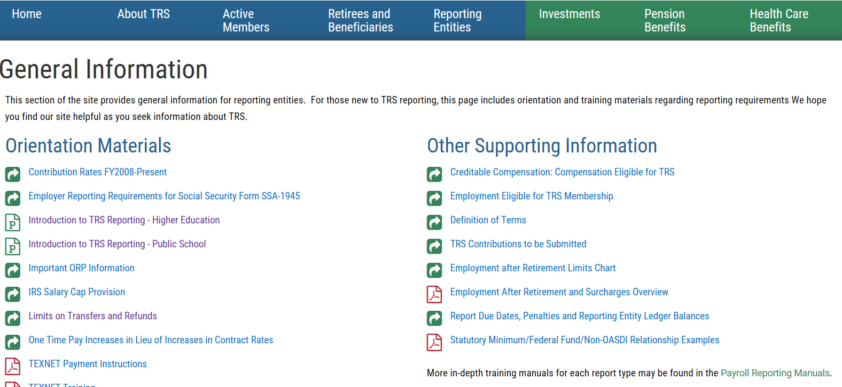
Online Resources for Creditable Compensation

Slide 35

TRS Member Contributions
Member Retirement Contribution
  7.7% of TRS Creditable Compensation
Special Service Credit Purchase
  Member must have active installment agreement with TRS for payroll deduction

Slide 36
Employer Contribution on the Regular Payroll Report
Higher Education Employers
  Federal Fund/Private Grant
  Reporting Employer Payment for New Members
  Non-educational/General-Funds (public senior colleges, universities, and medical and dental schools)
  Educational/General-Local Funds (public junior colleges, senior colleges, universities, medical and dental schools)
  Community/Junior College (community and junior colleges only)

Slide 37
RP Report – New Member
New Member Contributions are due on pay received during an employee’s first 90 days of TRS membership, not when the employee is paid for work performed during the first 90 days.
Do not report the new member with Federal Fund/Private Grant, Educational/General-Local, or Non-Educational/General Contributions until AFTER the first 90 days of employment (if applicable).
If employee termed in prior report period, current report period is only final compensation. New Member is not due for final month.

Slide 38
New Member Contribution Example
September
Started 9/1
20 days
$0 pay
October
Terminated 10/31
23 days
$5,000 pay
November
0 days
$5,000 pay
No New Member contributions due
Would not pay any other state contributions
New Member contributions due
No other state contributions
No New Member contributions due
Would pay any other state contributions

Slide 39

RP Report – Federal Fund/Private Grant
Purpose - to report on a monthly basis the total amount of salary paid from federal funds and private grants to TRS-eligible employees and to reimburse the State for the State contribution due on the salary

Slide 40
RP Report - Non-Education General
Purpose - to report on a monthly basis the total amount of salary paid from non-educational and general funds by senior universities, medical schools, and dental schools.
All funds except those funds used as a method of financing for an institutional appropriation in the General Appropriations Act or dedicated by the Constitution of the State of Texas.

Slide 41
RP Report – Education/General-Local
The purpose of the Education/General-Local Funds Contribution is to report on a monthly basis the total amount of salary paid from educational and general-local funds by senior universities, junior and community colleges, medical schools, and dental schools.
Education and General-Local funds are funds such as net tuition, special course fees, lab fees, student teaching fees, hospital and clinic fees, organized activity fees, proceeds from the sale of educational and general equipment, and indirect cost recovery fees. These funds are described in Section 51.009(c) of the Texas Education Code.

Slide 42
RP Report – Education/General-Local
Proportionality
Eligible Compensation Paid from Education/General Local funds should only be Fund 002 General Revenue-Dedicated (GR-D) funds.
Fund 001 General Revenue should not be reported on the Regular Payroll report.
Education/General-Local Contribution should only be calculated on Fund 002 GR-D
Use Proportionate rate set by APS 011 Benefits Proportional to Fund Report when reporting Education/General-Local to TRS

Slide 43

RP Report – Education/General-Local
Proportionality Example:
Eligible TRS Gross Compensation: $5,000
Reporting Employer’s GR-D Proportionality Percentage: 23%
On the RP 20:
  Eligible TRS Gross Compensation: $5,000
  Eligible Compensation Paid from Education/General-Local: $1,150.00
  Education/General Local Contribution: $78.20

Slide 44
RP Report – Community/Junior College
Junior colleges and junior college districts must pay the state contribution on:
  50% of Creditable Compensation for employees in positions that are eligible to be classified as instructional or administrative
  100% of the state contribution amount on all other TRS members employed by these entities.
The I&A staff must be reported under Position Code 01 or 02. All other employees must be reported under Position Code 03-07.
Employees that have multiple positions- must report under separate position code if each position’s eligibility for I&A differs

Slide 45
Head Count – Community/Junior College
May 2018 TRS Update Newsletter
The eligible head count are all Instructional or Administrative (I&A) staff who are benefits eligible.
The number of I&A staff that can be reported as qualifying employees cannot be adjusted in a proportion greater than the change in student enrollment.
The state contribution rate is not adjusted for student enrollment. Rather, it is the number of qualifying employees that is adjusted.
TRS does not monitor or administer the head count regulations. All records & documentation used by the reporting Employer, to verify the head count used, must be kept by the RE.

Slide 46
RP Report – Community/Junior College Examples
Employee is TRS eligible, I&A staff
  TRS eligible compensation: 5,000
  Eligible compensation paid from Federal Funds/Private Grants: 2,500
  Community/Junior College Contribution:
    5000 X 50%= 2,500
    2,500-2,500= No compensation is subject to CJ
    0.00 CJ Contribution
Employee is TRS eligible, non-I&A staff
  TRS eligible compensation: 5,000
  Eligible compensation paid from Federal Funds/Private Grants: 2,500
  Community/Junior College Contribution:
    5,000-2,500= 2,500
    2,500 x 7.5% = 187.50 CJ Contribution

Slide 47
RP Report – Community/Junior College Examples
Employee is TRS eligible, I&A staff
  TRS eligible compensation: 5,000
  Community/Junior College Contribution:
    5000 X 50%= 2,500
    2,500 X 7.5% = $187.50 CJ Contribution
Employee is TRS eligible, non-I&A staff
  TRS eligible compensation: 5,000
  Community/Junior College Contribution:
    5,000 X 7.5% = $375.00 CJ Contribution

Slide 48
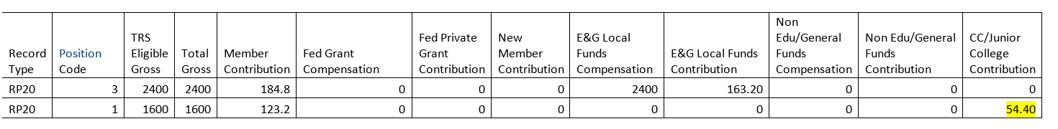
RP Report – Community/Junior College
We have employees with one job who are split between Auxiliary and Institutional (exempt). They have only one position number. If the employee only has one job but is paid through different funding sources, then the funding sources will be reported under one position as in line 1 below.
We also have employees with more than one job that are also different position numbers. My example is a full time Math instructor (2). She also tutors students part-time (1), and works with Adult Ed part-time (3).
If the employee has more than one job, and therefore needs to be reported under different position codes, then the calculations would work differently.
Notes:
Jill note: Should the position codes be 01, 02, 03 or do those references mean something else in this example?

Slide 49
RP Report – IRS Salary Cap Provision
The salary cap is based upon TRS’s plan year from September through August. Since TRS reports are based on when salary is paid (report when paid), we look at the September posting through August posting of each year. This is not a new requirement that resulted from implementation of our new system as the “report when paid” rules went into effect beginning FY2015.
In our August 2019 Update newsletter, we included an article as a reminder on the IRS Salary Cap for FY2020:
    The cap is based on the TRS plan year of September through August and not the member’s contract/work agreement year. Once the member’s reported salary beginning with the September posting reaches the salary cap for that year, no further salary is to be reported until the following September which is the beginning of the next plan year.
    https://www.trs.texas.gov/TRS%20Documents/update_aug_2018.pdf

Slide 50
RP Report
Report Types
Regular Payroll
(Current Month)
RP – Adjustment
(Ad-hoc adjustments)
Record Types
RP20 – Current Month
RP25 – Adjustment Record (add, edit or delete)

Slide 51


Reporting Requirements
Report salary when it is paid to the employee
  Regardless of when it was earned
Report time (days and hours) when worked
  Time reporting is not based on pay period

Slide 52

Hours worked vs. Hours Scheduled
For Active employees
  If an employee tracks their time (keeps timesheet or clocks in and out), you MUST report the actual hours worked in the calendar month
  If an employee does not track their time in any way, you will report the number of hours they are scheduled to work each week.

Slide 53

Part 2 - TRS Retired Employees
Lesson 1
Retiree Rules & Laws
View Employee Information
Half-time Exception
Independent Contractor
Lesson 2
ER Report
Surcharges
Common Errors

Slide 54
Who to Submit
Employment After Retirement
All
TRS
Retirees
Regardless of Retirement Date or Position

Slide 55
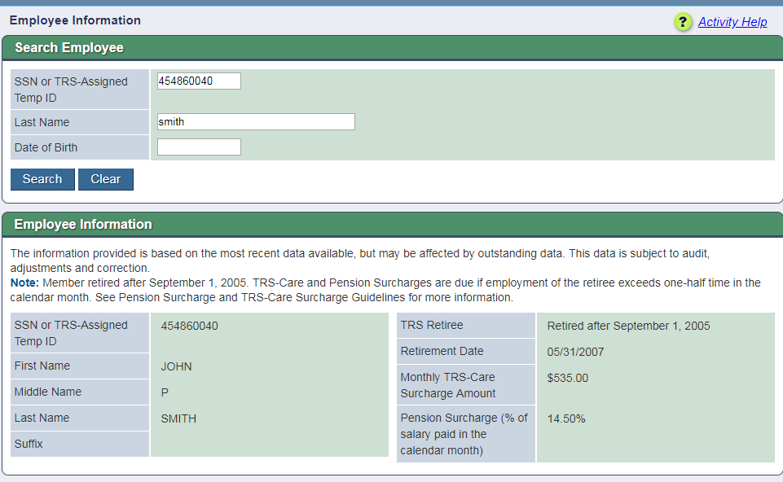
View Employee Information - TRS Retiree
Notes:
Why TRS no longer provides 12 Consecutive Month Break in Service information. If TRS gives wrong information, retiree could appeal. If your entity gives wrong information, cannot appeal.

Slide 56
Employment After Retirement: Three Categories
Retired BEFORE September 1, 2005 | Retired between September 1, 2005 – January 1, 2011 | Retired AFTER January 1, 2011
Retiree may work without limit and receive annuity | Retiree may work without limit and receive annuity | Retiree limited to working one half-time or less or substitute UNLESS there has been a 12-consecutive-month break in service
No surcharges due | Surcharges due if retiree works more than amount allowed | Surcharges due if retiree works more than amount allowed
Three Categories

Slide 57
One-Half Time
One-half time for Employment After Retirement AND Surcharges defined as:
  Working the equivalent of 4 clock hours each workday in the calendar month under the one-half time exception.
  The total number of hours allowed for that month may be worked in any arrangement or schedule.
  Workday is defined as Monday -Friday, regardless of whether reporting entity is open or closed.**
  When a retiree combines substitute and one half time employment in the same calendar month, the retiree may work only one-half the number of workdays in that calendar month.
  **This is for Employment After Retirement and Surcharge purposes ONLY - not Active members.

Slide 58

Time worked by Retirees
For TRS Retirees
  You MUST report the actual days and hours worked in the calendar month.
    Only exception is for Adjuncts, for whom you can convert their class hours to clock hours based on the calculations discussed in the following slides
  Reporting scheduled days and hours is not permitted

Slide 59
Adjunct Retirees – In Person Course Clock Hours Conversion
Courses Measured in hours or semester hours rather than clock hours
  Each hour of instruction in the classroom or lab will count as 2 clock hours*
  Must track and determine actual number of days worked each calendar month
Hours Worked Example:
  A TRS retiree is teaching a 1 semester hour lab at a college. The lab meets once a week on Mondays for 4 hours. The students receive college credit for the lab.
  If there were five Mondays in the calendar month, then the retiree would be reported as working 40 hours (8 x 5) for the month.
 | Number of Courses | Credit Hours per Course | Hours per Day | Days per Week course meets | Clock Hour Conversion Rate | Clock Hours per Week
In person 8 week course | 1 | 1 | 4 | 1 | 2 | 4 X 1 X 2 = 8
Notes:
If the employment is measured in course hours or semester hours rather than clock hours, each hour of instruction in the classroom or lab will count as 2 clock hours in order to reflect instructional time as well as preparation and other time typically associated with one hour of instruction. If your entity has established a greater amount of preparation time for each hour of instruction, the established standard will be used to determine the number of course or semester hours the retiree may teach without loss of annuity.

Slide 60
Adjunct Retirees – Online Course Clock Hours Conversion
Online and Hybrid Courses
  Each hour of college or semester credit given for the class will count as two hours worked in a week*
  Days worked based on comparable in person course
Hours Worked Example
  A 3 hour online or hybrid class- to calculate the Hours Worked in a month:
  Multiply the number of hours worked per day by the total days worked in a month to get the Hours Worked in a calendar month.
Credit Hours | Number of Courses | Conversion | Number of Hours per Week | Number of Days per week | Number of hours per DAY
3 | 1 | 2 | 3 X 1 X 2 = 6 | 5 | 6 ÷ 5 = 1.2 Hours
Notes:
Each hour of college or semester credit given for the class will count as two hours worked in a week. If your entity has established a greater amount of preparation time for each hour of instruction, the established standard will be used to determine the number of course or semester hours.
In February 2020, there are 20 work days. 20 X 1.2 hours = 24 hours worked in the month of February.

Slide 61
Employment After Retirement Limits Chart
Month | Total Number of Workdays in Calendar Month | Number of Hours a Retiree Working One-Half Time or Less May Work Without Triggering Surcharges | Number of Workdays Retiree Combining Substitute and Other TRS-Covered Employment May Work Without Triggering Surcharges
September 2019 | 21 days | 84 hours | 10 days
October 2019 | 23 days | 92 hours | 11 days
November 2019 | 21 days | 84 hours | 10 days
December 2019 | 22 days | 88 hours | 11 days
January 2020 | 23 days | 92 hours | 11 days
February 2020 | 20 days | 80 hours | 10 days
March 2020 | 22 days | 88 hours | 11 days
April 2020 | 22 days | 88 hours | 11 days
May 2020 | 21 days | 84 hours | 10 days
June 2020 | 22 days | 88 hours | 11 days
July 2020 | 23 days | 92 hours | 11 days
August 2020 | 21 days | 84 hours | 10 days
Example

Slide 62
ER Report – Independent Contractor
Retirees are considered Employees during the first 12 consecutive calendar months following retirement if they are performing duties or providing services for an educational institution that an employee of the institution would otherwise perform and work as an Independent Contractor.
RULE §31.11
Sec. 824.601

Slide 63
ER Report – Surcharges
Pension Surcharge is based on the pay received in the month the Retiree exceeded the half-time exception, regardless of when the money was earned.
TRS-Care Surcharge (if applicable) is due any month the Retiree exceeded the half-time exception.
September
Half-Time or Less
October
Full-time
November
Half-Time or Less
Three Categories
ER Limits Chart

Slide 64
ER Report
Report Types
Employment After Retirement
(Current Month)
ER Adjustment
(Ad-hoc adjustments)
Record Types
ER20 - Current Month Record
ER25 - Adjustment Record-Add
ER27- Adjustment Record-Edit or Delete

Slide 65
ER Report
The purpose of the Employment after Retirement Report (ER Report) is to report, on a monthly basis, the TRS Retirees returning to work.
Retiree hours, days and salary must be reported on all Retirees regardless of retirement date.
Surcharges are strictly based on the actual number of hours or days the Retiree has worked or was on paid leave during the calendar month.

Slide 66


ER Zero Signature
Submitting and confirming a zero signature will complete the ER report for that month.
If done in error, that month’s ER records must be submitted on an ER Adjustment report as ER25s.

Slide 67


ER Report – Overlapping Dates
Retiree began employment as a Half-Time or Less
employee.
In February, employee became a full-time employee.
September
August
Sep. 1st – June 1st , Position Code 02 Part-Time
Sep. 1st – June 1st , Position Code 02 Full-time
September
August
Sep. 1st – June 1st , Position Code 02 Part-Time
Feb. 1st – June 1st
Position Code 02 Full-time
September
August
Send ER27 on
ER - Adjustment Report to END first position
Sep. 1st – Jan. 31st
Position Code 02 Part-Time
Feb. 1st – June 1st
Position Code 02 Full-time

Slide 68

Reporting Employer Contacts
Required Contact Types
  Web Administrator
  Head of Institution
  Reporting Official
  Payroll Contact
Web Administrator
  Update Reporting Employer’s contacts
  Updated by TRS with TRS 597a form
  Role assigned by Head of Institution
  Reset passwords for internal users
Contacts on file for the Reporting Employer will receive valuable information from TRS

Slide 69

Online Training/Reporting Resources
Payroll Manual
Defect and Issues List
File Format Guides
Error and Warning List
User and Training Guides
Training Videos
Web Based Trainings
RE Portal Messages
www.trs.texas.gov > Reporting Entities
Reporting@trs.texas.gov
800-433-5734 – Requires four digit
Reporting Employer ID number

Slide 70

Resolving Errors
Error messages do not always tell the user exactly how to correct the error, but often, the error message can guide the user to the solution.
The following slides contain examples of common errors and the guidance contained in the error message:
Notes:
Error messages cannot always tell a user exactly how to correct the issue because the system does not know what is correct and what is not.
For example, if the error says an eD40 for Position Code 01 does not exist, but an ED40 for Position Code 02 is on file, which position code is correct?
The goal is to problem solve based on the error message shown by analyzing what the error means.

Slide 71
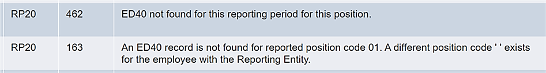
Error: ED40 not found
Consider:
  Has an ED40 been submitted for this position for this fiscal year?
    If yes, has the record posted/completed?
      If so, what were the employment dates on that ED40?
  Did the contract end prior to this report month?
    If yes, are you reporting time worked on this month’s record?
  Have you resubmitted the RP file after the ED records processed and posted?

Slide 72
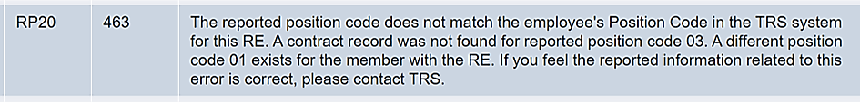
Error: Reported Position Code Does Not Match
Consider:
  Did the person change positions?
  Did they take on an additional job?
  Are you reporting the correct position code?
  Have you resubmitted the RP file after the ED records processed and posted?
Notes:
If there is not an additional job, but this is a TRS eligible stipend paid to an employee as part of their usual job it should be included with the employee’s regular position code. Check with your software provider to ensure that the stipend is coded correctly.

Slide 73
Reported information does not match TRS information
Consider:
  Verify that what you are reporting is correct.
  What was reported previously?
ED25
Update Name, Date of Birth, Gender, ID/SSN
  Reported Name must match Social Security card
  Date of Birth and Gender must match government issued ID
ED45
Update any information previously reported on an ED40.

Slide 74
Contribution of xx is not correct amount. Contribution is xx%
Consider:
  Is this an adjustment for a previous month or year?
    If so, was any contribution reported on the original record and are you considering that in these calculations?
  Is this a current month record?
    If so, verify that all the compensation amounts from various funding sources is accurate.
Notes:
If adjusting a previous year, were the contribution rates different at that time?
Review the interaction between Federal Funds, Statutory Minimum, and Public Education Employer Contribution :
https://www.trs.texas.gov/Pages/re_statutory_minimum_examples.aspx

Slide 75
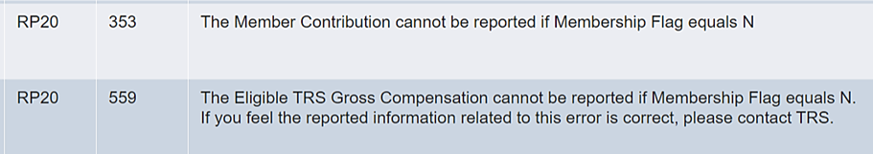
Cannot report XX contributions when membership flag is N
Consider:
  Has the person changed eligibility status?
    If so, has an ED45 been submitted to update the eligibility flag?
  Is this final pay from a previous position that was eligible?
Notes:
If the person is/was not eligible and contributions were withheld in error, refund them back to the member.

Slide 76
Member contributions must be reported when membership flag is Y
Consider:
  Is the person TRS eligible?
  What was the eligibility flag on the ED40?
  If it was Yes, why aren’t eligible compensation and contributions reported?
  Has the person changed eligibility status?

Slide 77
Cannot change membership flag due to posted transactions
Consider:
  Was eligibility reported incorrectly back to beginning of contract?
  If changing to No-
    Were any TRS contributions reported?
  If changing to Yes-
    Will you be going back to beginning of current eligible contract and collecting contributions?
  Has the person changed eligibility?
Notes:
ED45 functionality-
Edit vs. End/Add
ED45 - Contract & Position Adjustment Record - Examples
Edit a previously submitted and TRS-accepted ED40 record. If the position code, dates, or any other information were wrong on the original ED40, submit an ED45 with an Adjustment Reason Code of “E” (Edit) and put the corrected information in the applicable “New” fields. The ED45 must have the exact same Beginning Date of Contract/Work Agreement for the same FY as the originally accepted contract. The original contract is voided and is replaced by the information on the new ED45.
End/Add a previously submitted and TRS-accepted ED40 record. This allows the ED45 to both end an existing contract/position record and start a new contract/position going forward. Unlike an Edit, the End/Add functionality does not replace the original contract/work agreement as it remains on the system. The original contract/work agreement is given a new ending date of the day prior to the beginning date of the new contract/work agreement and another contract/work agreement is added to the system using the new information on the ED45. Instead of submitting an ED45 to end the old position and then submitting an ED40 to start the new position, an ED45 with an Adjustment Reason Code of “A” (End/Date) can be reported to reflect a change in position. All “New” fields need be to be reported if the Adjustment Reason Code is “A” even if the previously reported data will be the same for the new position.

Slide 78


Verify Membership Eligibility
Consider:
  Are reported hours correct?
  Did person change positions/eligibility?
Notes:
If eligibility has not changed, provide answers to the following questions to your coach for an override:
How many hours per week employee hired to work?
The position’s FTE (must be either 00 or between 30-40)
Explanation why hours are more or less than expected for this report month
Statement of when employee is returning to agreed upon hours

Slide 79
ER-Reporting information does not match reported data from prior report period
Consider:
  Has retiree’s position code, employment type, or employment dates changed?
  What was reported on the previous month’s report for these fields?
Notes:
Retiree Employment type is based on what retiree actually did that month, not what they were hired to do.
If there have been no changes, edit the current record to match what was previously reported.
If any changes have occurred, an ER27 to adjust the previous month and end that position must be sent.

Slide 80
Software Provider or TRS?
Who to contact for help
Software Provider support:
  Lead Record error---totals in report do not match lead record
  Errors in your software
  Reports not generating from your system correctly---pulling additional records, putting people on wrong report
TRS Coach:
  Report has been uploaded and processed and assistance is needed with error
  Clarification on TRS Laws and Rules
  Employment after Retirement rules regarding surcharges
Notes:
Contact a TRS Benefit Counselor for:
Any member questions regarding general account information, and:
Refunds
Retirement Benefits
Death Benefits
Employment after Retirement rules regarding retiree limits
In most cases, the member must contact TRS themselves---TRS is not able to provide member account information to the employer without authorization from the member.

Slide 81
Communicating with your coach effectively
Compile all questions into one email whenever possible
Be as clear and complete in your question as possible---give details
Send full screenshots—not just the error message itself
If coach gives instructions to make corrections, follow them in order
Notes:
Please ensure you are sending any emails that contain personally identifying information in a secure or encrypted manner.
Information to include in your email:
What report is this on?
What employee is the error on?
What have you tried to resolved the error on your own?
If so, what have you tried?
What errors are you getting?
If position changes occurred, include dates.

Slide 82
Overrides
Amount of time to prepare an override
  approx. 1-5 minutes for each record being overridden
Documentation Required
  screenshot of the record
  communication from RE explaining why override is needed
  screenshot of contracts on file
  screenshot of TRS28
  screenshot of transactions screen
Notes:
Some overrides are due to defects. Many are due to validations working exactly as designed, but reported information is correct. Overrides are a way for TRS to verify that reported information fits within TRS Laws and Rules.
SAO requires full documentation of explanation and support for all overrides.

Slide 83
Coach Statistics
1330+ active Reporting Employers
17 coaches (including 4 in training)
Coaches work with between 85-130 Reporting Employers
Notes:
Training time for new coaches is 6-8 months
Currently 2 vacancies for coaches remain
Average number of phone calls per month:
Incoming: 307
Outgoing: 707
Voicemails received: 355
Average time for incoming calls: 26 minutes
Average time for outgoing calls: 10 minutes
Average number of emails per week:
Incoming: 3808
Outgoing: 2701
Average number of overrides processed per month:
449

Slide 84
Available Resources
  Custom Web Messages
  Error messages
    Think about ‘Considerations’ on previous slides
  Errors and Warnings list
  Report Format Guide
  Payroll Manuals
  Current Defects and Issues Document
  Update Newsletters
  Employer Advisory Group members
Notes:
TRS launched the Employer Advisory Group (EAG) in 2017 to facilitate communication between TRS and Employers.
The EAG’s purpose and goal are for TRS and Employers to have a common understanding of any issues related to reporting requirements and work together jointly to identify practical ways to comply with new laws, rules, and accounting requirements.
The group includes TRS Benefit Services Staff and representatives from all reporting employer types, sizes and locations. Their participation is voluntary and does not imply that the members are in agreement with all decisions ultimately made by TRS.
If there are issues or questions you would like to be brought up in an EAG meeting, please visit the TRS Website for a list of EAG members and contact the representative for your region.

Slide 85
Empowerment
Try it! Everything can be fixed
Believe in your knowledge-you know more than you think
Trust your abilities
Use your resources
We believe in your knowledge and abilities!

Slide 86

Please reach out to your coach or reporting@trs.texas.gov if you have any questions or need assistance.

